Slide 1
Campaign Analytics

Slide 2





Campaigns – Connecting with the customer
The Lifecycle of a customer, and how she engages with an institution is dependent on how the institution interact with her
Engage
Loyalty
Advocacy
Engagement
Awareness| Reward
Awareness
Celebrate
Customer Engagement Life-Cycle
Reward | Retain | Refer
Grow
Awareness | Reward | Stretch
Retain
Reward | Retain

Slide 3



Types of Campaigns
Customer Life-Cycle (CLC) Campaigns
Promotional Campaigns
First Purchase
All Purchases
Lead Generation
Prospecting
Promotional Events
Welcome
Thank You
Congratulations
Feedback
Product Review
Festival
Campaigns
Win-back Campaigns
Cross-Shop
Trade Drivers
Campaign Strategies
Campaign Channels
Awareness| Reward | Retain | Stretch | Refer | Win-back
Direct Mail | E-Mail | SMS

Slide 4



Campaign Management Framework
Campaign Design
Campaign Execution
Campaign Measurement

Slide 5
Campaign Design
What is the campaign set to achieve?
What are the hard and soft metrics aligned towards that objective?
Campaign Objective
Campaign Eligibility
Who should be contacted for this campaign?
Are there customers who do not want to be contacted?
Campaign Design
What should be the offering to the customers? What
How frequently would we contact customers? When
Should all eligible customers be contacted? Who
Which channel would be more effective? How
Campaign Characteristics
Campaign Optimization
How can the campaign be profitable?
How can the campaign be more effective?

Slide 6



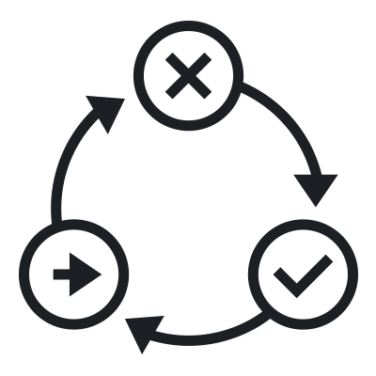

Campaign Execution
Creative/Script Design
Email/SMS Content
Standard Headers and Footers
Tool Specific Links
UTM Code and Personalization
Campaign Implementation Planning
List Creation/Auditing and Sign off
Contact Information Checks
Personalization Fields
Standard Exclusions check
Final confirmation on counts
Campaign Execution
Campaign Creation in the tool
Campaign Details (Subject Line)
HTML Upload
Data Upload and mapping
Campaign
Rollout
Testing and Approval
HTML and Personalization Testing
Creative Mapping
Delivery Testing and Approval
Campaign Launch
Comparison with Test Campaign and Final Delivery
Scheduling
UTM – URL Tracking Metrics

Slide 7
Campaign Measurement
Reporting measures –
Delivery Rate
Open Rate (only for Email)
Response Rates (primary and secondary)
Track Fulfilment and Response
Campaign Measurement
Short Term Measures
Short Term Impact of the Campaign to measure –
Campaign Effectiveness (Open Rates and Response Rates)
Short Term Sales Uplift (pre-post analysis)
Test and Control Design
Statistically measure effectiveness of campaigns to primarily measure incremental revenue

Slide 8

Exercise 1
An electronic retailer has an annual campaign, where they want to target their good customers with the product they would need.
Who is a good customer?
A good customers is one who has shopped at least twice and spent at least Rs 10,000 in the past 1 year
What you have –
Details about all the transactions that customers have made in the past 1 year.
What is the objective of the campaign?
How would you define campaign eligibility?
What would be the campaign characteristics?
15 min

Slide 9

Campaign Analytics Concepts

Slide 10









Targeted Models
Statistical model based targeting leads to better and effective selection by increasing the probability of response
Using factors which impact the decision of the customer to respond improves the effectiveness of the campaign
Sample emulates the behaviour of the population
More likely to respond
Entire Population
Random Selection with fulfilment criteria
Entire Population
Less likely to respond
Primary Statistical Methods used
Simple Random Sampling | Stratified Sampling | Hypothesis Testing
Primary Statistical Methods used
CART | CHAID | Logistic Regression

Slide 11
Exercise 2
An electronic retailer has an annual campaign, where they want to target their good customers with the product they would need.
Who is a good customer?
A good customers is one who has shopped at least twice and spent at least Rs 10,000 in the past 1 year
What you have –
Details about all the transactions that customers have made in the past 1 year.
What all factors would impact responsiveness of the customers?
How will you find out which product to give whom?
15 min

Slide 12

Fred Weasly
George Weasly

Slide 13




Test and Control
Fred
George
Fred
George
Campaign is sent
Fred
George
George
Incremental Value
Benefit brought in
Fred
T - x
T
T + a
T + a + b
Time
Test and Control methodology helps us to understand the effect of a treatment on a subject
Primary Statistical Methods used
T-test| ANOVA| ANCOVA| DOE

Slide 14
Exercise 3
An electronic retailer has an annual campaign, where they want to target their good customers with the product they would need.
You have the details about who was sent a campaign and who responded
Calculate the Incremental Revenue brought in the by the customer
10 min

Slide 15
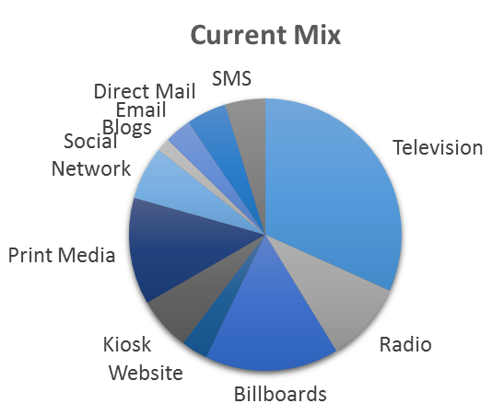
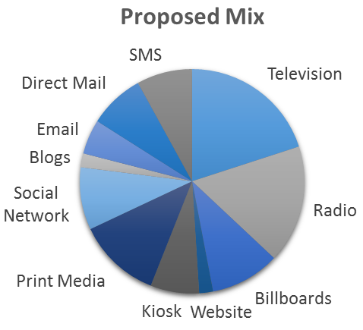






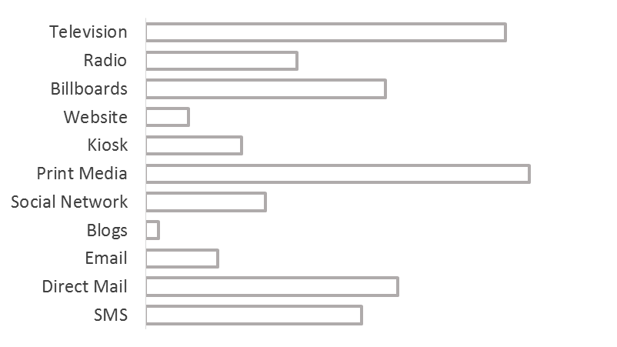
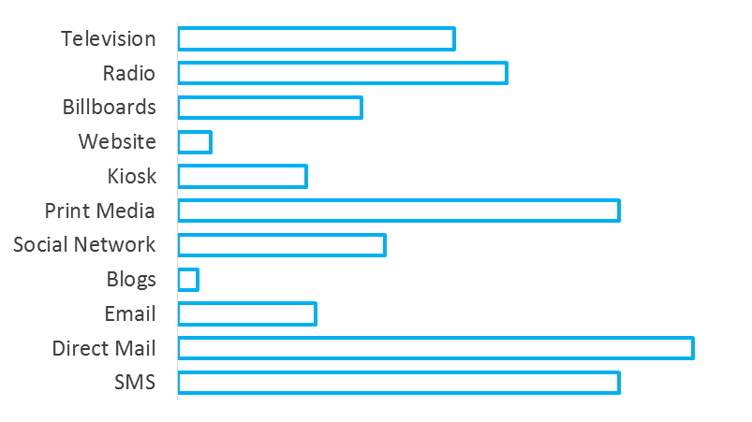








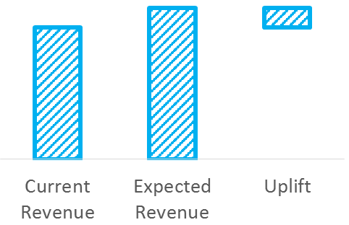
Market Mix
Media Spend Mix
Revenue Mix
Incremental

Slide 16
Recap
Customer Life Cycle
Types of Campaigns – CLC and Promotional
Campaign Management Process
Campaign Design
Campaign Execution
Campaign Measurement
Campaign Concepts –
Targeted Campaign Models
Test and Control framework
Market Mix

Slide 17
Thank you

